Slide 1
ACGME Program Strategic Growth
Defining a Streamlined Process
Margaret Damiano, MBA
Associate Dean, Administration and Finance, ZSFG
Kathy Julian, MD
Associate Dean for GME

Slide 2
Strategic Growth Workgroup - Deliverables
Deliverable 1: Recommendation of process and annual timeline to review program requests for expansion and establishment of new ACGME programs Current Process: each Department negotiates with individual health systems
Problems We Are Trying to Solve:
Presently there is no streamlined process
Each Department negotiating independently
Dependencies of decisions not included: impacts to other health systems, programs, and other limited resources (space, parking, etc)
Stakeholders have different elements to bring to the discussion (strategic growth, available job markets, State of CA needs, etc)
Increase transparency of decision-making and opportunity for programs to put forward requests
Align decision-making timelines with ACGME timelines
Notes:
Specific composition to reflect Executive Level, All Health Systems, All components that inface with the programs

Slide 3
Strategic Growth Workgroup – Request Submissions
Process applies to following types of requests:
New ACGME program creation
Permanent complement expansion
Changes to clinical schedule at health systems as follows:
Any increase of ZSFG FTE
Any increase of 20% or more FTE at UCSF Health
Any increase of 20% or more FTE at VAMC
Change non-ACGME program to ACGME program
Online submission form with standardized information request created for Department to submit and initiate the growth request process

Slide 4
Strategic Growth Workgroup – Proposed Approval Process
GMEC
Members:
1. Program Directors
2. Program Administrators
3. Trainees
4. GME leadership
ACGME Expansion Committee
Members (or designee):
SOM Dean
Final approval l
Criteria:
1. Meets ACGME criteria
2. Has educational value
3. Potential impacts to other programs or health systems
UCSF Health: CFO & CMO
ZSFG: Vice Dean & CEO
Criteria:
VAMC: Assoc Chief of Staff for Education
SOM: DIO
Chairs: 3 (surgical, non-surgical, hospital)
Vice or Associate Chair for Education
Clinical Workflows/Staffing levels
Wellbeing
Future workforce needs
Resources (funding, space)
ACGME compliance (citations, workhours, etc) as detailed by submission form
Stakeholders Input*
SOM Dean (with DIO Input): Review and prioritization
Health System Leadership (with Strategy Input): Review and prioritization
ACGME Residency Review Committee (RRC)
Review and approve
*ACGME Expansion Committee members seek input prior to meeting

Slide 5
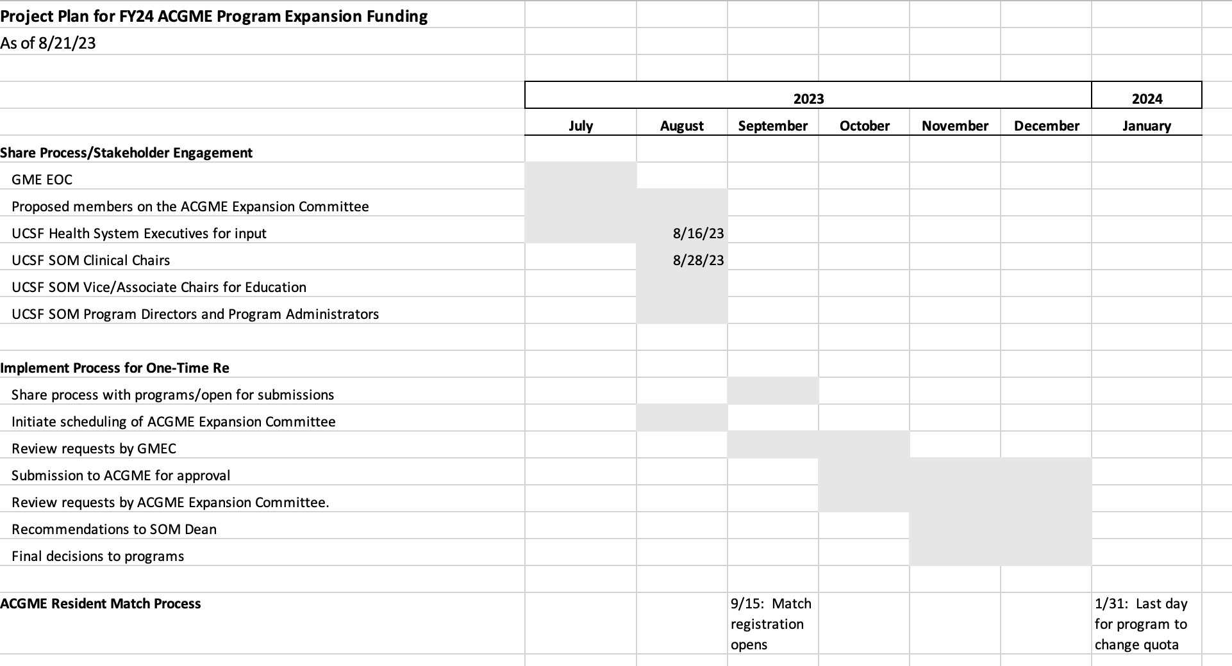
Strategic Growth Workgroup – Project Plan
Updates
Notes:
Specific composition to reflect Executive Level, All Health Systems, All components that inface with the programs

Slide 6
Frequently Asked Questions
Why does the Dean need to approve ACGME Expansion Committee’s Decision
SOM is Sponsoring Institution for GME
Would be unusual for Dean to override expansion committee approval
How is a decision made if respective health systems disagree?
Committee will need to discuss
Should ACGME RRC approve before expansion committee?
Unusual for ACGME RRC to not approve growth request
Won’t this timeline take too long?
Quarterly requests to expansion committee; three-month process
Does initiation of non-ACGME program need to be approved by expansion committee?
No, starting non-ACGME program will require GMEC approval only UNLESS non-ACGME program converting to ACGME program

Slide 7
Frequently Asked Questions
Given limited resources, how will we ensure that the available funds are distributed equitably to departments [rather than first come, first served, and then run out of money]?
Will await final funds flow and then will need to distribute funding throughout AY
Given limited resources, what criteria will be used to prioritize requests [so that decisions are not seen as arbitrary]?
The growth committee does have criteria but will need to work on prioritization and making this transparent
If a program has already been approved by the RRC for a larger complement, do they have to go through this process?
Yes
What happens if the available funds are exhausted, but a department is required by their RRC to increase their complement?
We have not seen this occur (yet), but if it were to occur, the DIO would work with the involved Department and Health System(s)

Slide 8
Questions/Comments
Concerns about this process?
Discussion with Dean, Health System Leaders and Executive Oversight Committee
Departments should NOT be able to fund ACGME program expansion if denied by growth committee
Final UCSF Health amount towards growth pending final funds flow
Soliciting nomination/voting for Chair members of expansion committee

