Slide 1
Committee on Space Academic Senate Orientation

Slide 2
What is the Academic Senate?
Notes:
Shared governance

Slide 3
The Academic Senate plays many roles on campus
Serves as the governing body of the faculty
Advises the Chancellor on the promotion and appointment of faculty
Enables faculty to exercise shared governance of the University
Advises the Chancellor and President on campus and University budgetary matters
Academic Senate
Represents faculty in all 5 academic series (UCSF only)
Has delegated authority over courses, curricula, and degrees.

Slide 4
Notes:
https://senate.ucsf.edu/sites/default/files/documents/orgchart.pdf

Slide 5
High-level Senate organization
Academic Senate
Systemwide
Academic Council
Standing Committees
Task Forces
UCSF Division
Executive Council
Standing Committees
Faculty Councils
Task Forces
UC Health
UCSF Health
AS Committee on Space

Slide 6
UCSF Senate Committees
Standing Committees
Faculty Councils
Academic Freedom
Academic Personnel
Academic Planning & Budget
Clinical Affairs
Committee on Committees
Courses of Instruction
Educational Policy
Equal Opportunity
Faculty Welfare
Graduate Council
Library & Scholarly Communication
Privilege & Tenure
Rules & Jurisdiction
Research
Space
Sustainability
Dentistry Faculty Council
Medicine Faculty Council
Nursing Faculty Council
Pharmacy Faculty Council

Slide 7
Senate committees can engage with issues in several ways
What can we do?
What are our tools?
Elevate
Amplify
Advise
Endorse/Oppose
Meetings
Letters
Faculty Outreach
Events
Voting
Notes:
Our charge is to focus on areas of concern where we can make improvements in the research enterprise at UCSF and to elevate those concerns and articulate to those concerns to leadership for change.

Slide 8
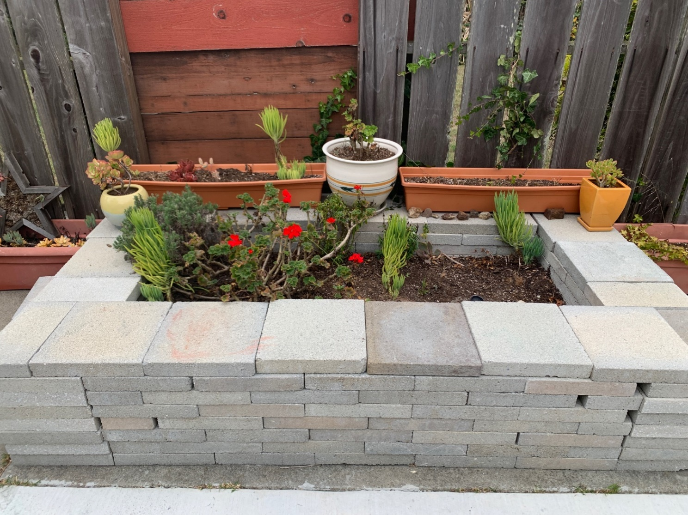
Governance Gardeners
Notes:
Things will die. Things will thrive despite us; others will thrive because of us. Things will be overwatered. Things will not get enough water. We are not going to become professional gardeners. We only meet for 16 hours over the course of the year. We recognize that our influence is limited but it is also real, so let’s plant some seeds, remember to water them, and see what we can grow.

Slide 9
What is the Committee on Space?
Notes:
Shared governance

Slide 10
Duties (from the bylaws)
Set general principles and goals to guide UCSF space stewardship, including maintenance of existing infrastructure, making recommendations regarding occupancy of new and renovated buildings, monitoring space usage and occupant satisfaction.
To maintain liaison with other committees of the Division, Chancellor- appointed committees, and Faculty Council of the Schools on matters related to space.
Coordinate Senate efforts and input into UCSF space planning committees and subcommittees, including COLASC, which per Bylaw 165.B. has authority over library space. Senate input and comments over space planning may include, but is not limited to, the occupancy of new buildings, and modifications to existing buildings and structures.
Report quarterly to the Executive Council and annually to the Division on UCSF space planning, as well as related policies and initiatives.
To consider and report upon such matters as may be referred to it by the President of the University, the Chancellor, the Division, any Faculty Council, or other committee of the Division.

Slide 11
ASCOS meets with campus leaders to discuss UCSF space issues
Some of last year’s guests
Guests scheduled for this year
(so far)
Catherine Lucey, Executive Vice Chancellor and Provost
Hal Collard, Vice Chancellor of Research
Robert Blelloch, Faculty Space Review Committee Chair
Elena Fuentes-Afflick, Vice Dean for the UCSF School of Medicine at ZSFGH
Neil Powe, Chief of Medicine at ZSFGH.
Maye Chrisman, School of Medicine (SOM) Vice Dean for Administration and Finance
Dave Morgan, SOM Vice Dean for Research. Rick Larsen, Director of Research Informatics
Jerome Sak, Executive Director, Institutional Analysis & Decision Support
Robert Blelloch, Chair, Faculty Space Review Committee

Slide 12
For discussion: Ongoing issues and priorities for the year
Parnassus Space Planning and Transferring Lessons Learned from the ZSFGH Pride Hall
Transparency and Equity in Space Allocations
Building Programming and Governance
Remote Work and Its Implications for Space
Effective Assessment of Space Utilization
Sustainability and Space
Policies Governing the Use of Shared Spaces
What else should be on this list?
Who do we want to meet with this year?

