Slide 1
HDFCCC Gender Equity Committee - Survey Results
Bridget Keenan, MD PhD
Katherine Van Loon, MD, MPH
Division of Hematology and Oncology, Department of Medicine

Slide 2
Agenda
Gender disparities within Academic Oncology
Review of the HDFCCC Gender Equity Survey
Introduction
Results
Discussion of key takeaways
Next steps – action and advocacy

Slide 3
Leadership Pipeline Gets Leaky Early
Notes:
Bridget
This data by LeanIn.org and McKinsey demonstrating the attrition of women as you move “up” the typical corporate ladder
The same happens in STEM professions, including academia, research and medicine. Women, especially women with young families, leave the pipeline faster than men and often within 5 years of launching their careers.
So, it’s not just that women are underrepresented at the highest levels, they are underrepresented increasingly at each career stage along the way

Slide 4
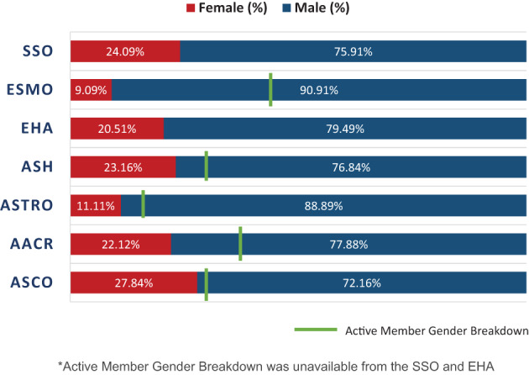
Women are under-represented in oncology leadership roles and in society awards
Chowdhary et al, 2020, Jama Netw Open
Patel et al, 2021, The Oncologist
Notes:
Bridget
In this study of gender representation in academic oncology, we found that women composed a minority of MO (37.1%), RO (30.7%), and SO (38.8%) faculty. Underrepresentation of women was particularly pronounced at the leadership level, with only 31.4%, 17.4%, and 11.1% of program director and chair positions in MO, RO, and SO, respectively, occupied by a woman. When restricting for only the chair position, representation of women was even lower at 21.7%, 11.7%, and 3.8% in MO, RO, and SO, respectively. We also tested the hypothesis that individual departments that had at least 1 woman in a leadership position would be associated with a higher proportion of overall women faculty, and this proved to be true for MO and RO, but not SO.

Slide 6
How Has COVID-19 Impacted Women in Medicine?
Emerging Data:
Decreased women authorship
Added early career barriers, especially for those with caregiving responsibilities
Disproportionate impact on women of color and women with caregiving responsibilities
20% of women surveyed in 2020 were considering leaving academic oncology
References:
Anderson et al, Elife 9/2020
Gewin, Nature June 2020
Cardel, et al. Ann Am Thorac Soc July 2020
Merfeld, JAMA Network Open, 2021
Image Source: New York Magazine
Notes:
Lek
According to the National Women’s Law Center, women have lost 5.4 million jobs since the pandemic began, with 2.1 million dropping out of the workforce entirely. The percentage of women in the workforce is now as low as it was in 1988.
Suggested impact is mixed:
Broad concern for how the coronavirus crisis is hurting women—from spikes in domestic violence, to the potential rollback of diversity initiatives, to the considerable share of women thinking of quitting their jobs.
Some economists are projecting that there may be long-term gains around home-care especially in households where the female parent is an essential worker and the male parent is not and, therefore, shoulders more home responsibilities.
Data so far tell a story that sheltering in place is largely hurting careers of women in medicine and science.
From Anderson et al ELife
Here we report the results of an analysis that compared the gender distribution of authors on 1893 medical papers related to the pandemic with that on papers published in the same journals in 2019, for papers with first authors and last authors from the United States. Using mixed-effects regression models, we estimated that the proportion of COVID-19 papers with a woman first author was 19% lower than that for papers published in the same journals in 2019, while our comparisons for last authors and overall proportion of women authors per paper were inconclusive. A closer examination suggested that women's representation as first authors of COVID-19 research was particularly low for papers published in March and April 2020.
From Nature: Submissions to preprint servers, such as arXiv, rose more quickly for male authors than for female authors as nations adopted social-isolation measures. And female authors have accounted for only one-third of all authors on published COVID-19 papers since January 2020.
Many articles documenting negative impact on early career scientists and women in medicine
Impact on training
More women limiting work access or pulled from work due to pregnancy

Slide 7
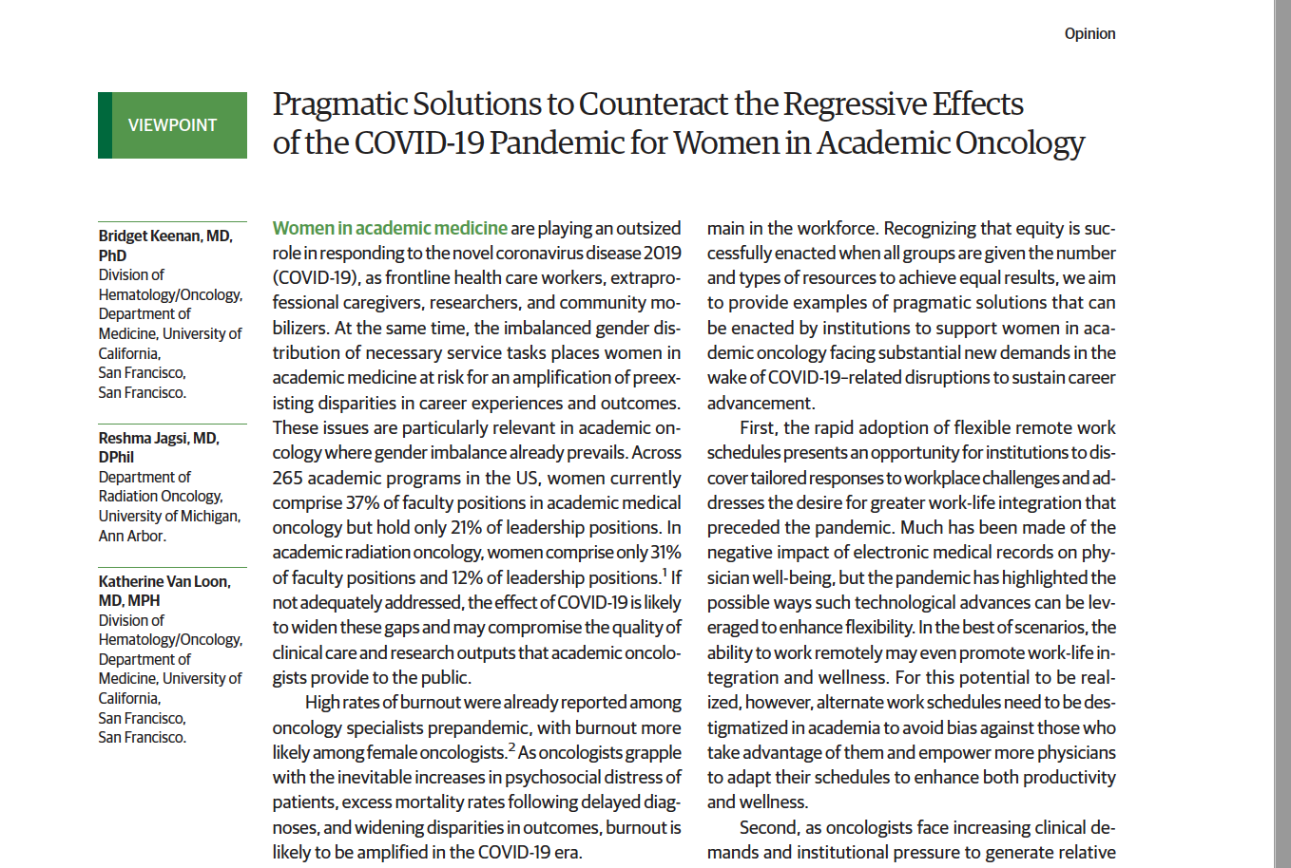
Graphic @AnaVManana
Notes:
Bridget

Slide 8
Gender Equity Committee
Commissioned by Dr. Ashworth in Spring 2021 in response to gender-related disparities and challenges that COVID-19 brought to light
Our Mission Statement: To promote and foster a supportive environment that advocates for the equitable advancement of women and gender minority leaders in cancer care, education, and research
First task – determine the extent and specifics of gender-related disparities at HDFCCC to determine how to best address these

Slide 9
Gender Equity Committee
Invited and self-nominated representatives from cancer-related specialties:
Hematology/Oncology
Pediatric Oncology
Radiation Oncology
Neuro-oncology
Surgical Oncology
Urology
Basic Sciences
HDFCC staff members

Slide 10
Measure of Culture Conducive to Women’s Academic Success (CCWAS)*
Culture
Conducive to
Women’s
Academic
Success
Freedom from
Gender Bias
Support for
Work-life
Balance
Equal Access
to Opportunities
Chair/Chief
Support
Westring et al. Acad Med. 2016

Slide 11
Gender Equity Survey
This survey collects data in 4 key domains:
Equal access to resources
Work-life balance
Freedom from gender bias
Leader support
We adapted the CCWAS survey with intention to collect data from all gender identities, not just women.
In addition, we added a few short questions about Burnout at the end.
Designed for faculty and will be adapted for staff, trainees

Slide 12
Methods
Survey dates: completed between 9/13/21 and 10/21/21
Survey distribution/communication
Emails sent from Director’s account to all Cancer Center members (n=489) – 9/13/21, 9/23/21
Reminder included in Cancer Center Newsletter to all CC members – 10/6/21
Verbal reminder during Town Hall for Cancer Center members – 9/22/21
Personal outreach to specific Divisions
Survey completion
181 surveys started
13 respondents who only completed initial demographic questions and nothing else were removed for analysis
8 surveys (4 pairs) were possible duplicates based on similarity of some write-in responses but answers on Likert scale varied so both were kept in for analysis

Slide 13
Methods, continued
Analysis
Population: for analysis compared between genders, 4 respondents who did not disclose their gender were excluded. These 4 respondents were included in the overall tables where results were not divided by gender.
Frequencies and percentages were used to describe all responses to the questions
Pearson’s Chi-squared test was used to evaluate the differences in distribution between men and women
Statistical significance is based on p<0.05. No testing adjustments were performed.
Notes:
Pearson Chi-square – to look for differences in distribution between men and women. Used this in tables as it makes fewer assumptions than in Kendall’s Tau. Shows difference in distribution but not implying difference on directionality
Kendall’s Tau - to examine ordered strength of relationship – for ordinal data

Slide 14
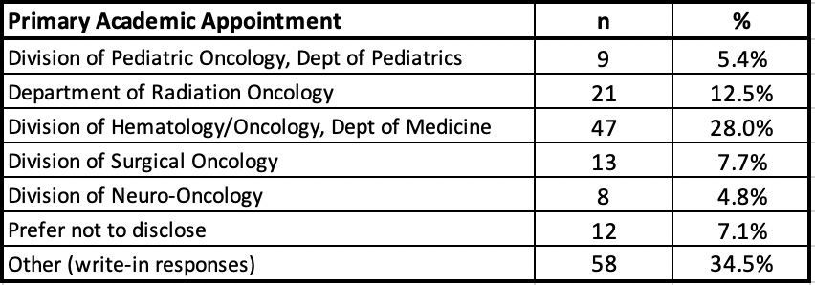
Demographics – 168 respondents across HDFCCC
Primary caregiver for children younger than 18 years old

Slide 15
HDFCCC Faculty Survey Results
Are you a primary caregiver for children younger than 18 years old?
During your time as a faculty member at UCSF, has your promotion schedule been on time, accelerated, or delayed?

Slide 16
Burnout
Significant by caregiver status and gender
Caregiver

Slide 17
Equal access to resources
I am frequently considered for leadership positions and given protected time and appropriate compensation for those roles
I have equal access to career development opportunities
I receive mentoring from those in senior roles
*Statements outlined with a box are significantly associated with gender, with p<0.05

Slide 18
Equal access to resources
I am frequently recognized for my work productivity and efforts
I receive frequent feedback regarding my performance
I receive adequate guidance about potential research opportunities
*Statements outlined with a box are significantly associated with gender, with p<0.05

Slide 19
Equal access to resources
Others are given credit for my work
I am often asked to sit on prestigious committees.
I am frequently nominated for awards and honors
*Statements outlined with a box are significantly associated with gender, with p<0.05

Slide 20
Equal access to resources
My comments and suggestions in meetings are given equal credit and attention
I am frequently included in professional social gatherings (e.g., dinners with guest scientists)
I am often included in informal social gatherings (e.g., sporting events, happy hours).
*Statements outlined with a box are significantly associated with gender, with p<0.05

Slide 21
Equal access to resources
I have equal access to administrative support as other faculty
I receive equitable pay, on par with other faculty.
I receive as much office space as other faculty
*Statements outlined with a box are significantly associated with gender, with p<0.05

Slide 22
Equal access to resources
I have as much protected time for research as other faculty
I have access to research space/equipment
*Statements outlined with a box are significantly associated with gender, with p<0.05

Slide 23
Work/Life Balance
Faculty who reduce their work load are viewed by other faculty as less committed to their careers.
Faculty are supportive when other faculty talk about work-family issues.
Faculty are supportive when other faculty take time for family life.
*Statements outlined with a box are significantly associated with gender, with p<0.05
Notes:
Common key themes in the write in responses included:
A culture of over-work
Little priority given to work/life balance
Lack of appreciation for factors that may contribute to work/life balance such as administrative support
Need to set up coverage on one’s own for family leave and conversely, those without caregiving responsibilities being asked to take on more work

Slide 24
Work/Life Balance
Faculty who temporarily reduce their work load for parenting responsibilities are expected to take on extra work when they return
Reducing their work load hurts the chances that faculty will succeed in their careers
Family demands are considered when the Division/Department schedules events and/or meetings
*Statements outlined with a box are significantly associated with gender, with p<0.05
Notes:
Common key themes in the write in responses included:
A culture of over-work
Little priority given to work/life balance
Lack of appreciation for factors that may contribute to work/life balance such as administrative support
Need to set up coverage on one’s own for family leave and conversely, those without caregiving responsibilities being asked to take on more work

Slide 25
Work/Life Balance
Faculty members who have children are often not offered research and leadership opportunities
It is possible for faculty to get promoted working 50 hours per week or less on a regular basis.
*Statements outlined with a box are significantly associated with gender, with p<0.05
Notes:
Common key themes in the write in responses included:
A culture of over-work
Little priority given to work/life balance
Lack of appreciation for factors that may contribute to work/life balance such as administrative support
Need to set up coverage on one’s own for family leave and conversely, those without caregiving responsibilities being asked to take on more work

Slide 26
Leader Support
My Chair/Chief tries to ensure that all faculty have equal access to support and resources to help them in their careers
My Chair/Chief tries to ensure that all faculty are equally recognized and rewarded for their work
My Chair/Chief tries to ensure that all faculty are included in FORMAL Division events
*Statements outlined with a box are significantly associated with gender, with p<0.05

Slide 27
Leader Support
My Chair/Chief encourages faculty to take advantage of policies/practices for managing work and family
My Chair/Chief tries to ensure that all faculty are included in INFORMAL Division gatherings (e.g., coffee, lunches, sporting events, etc.)
My Chair/Chief is supportive when faculty talk about work-family issues
*Statements outlined with a box are significantly associated with gender, with p<0.05

Slide 28
Leader Support
My Chair/Chief sends a message that parenthood is an accepted part of life.
My Chair/Chief sends a message that parenthood is an accepted part of life.
My Chair/Chief ensures work coverage for faculty on parental leave
*Statements outlined with a box are significantly associated with gender, with p<0.05
Notes:
My Chair/Chief tries to ensure that all faculty feel free to express concerns about gender equity.

Slide 29
Leader Support
My Chair/Chief tries to ensure that all faculty feel free to express concerns about gender equity
My Chair/Chief tries to ensure that all faculty are not sexually harassed.
*Statements outlined with a box are significantly associated with gender, with p<0.05

Slide 30
Leader Support
My Chair/Chief tries to ensure that faculty are not subject to subtle gender-based biases
It is accepted to take time off to prioritize ones physical and mental health when needed
*Statements outlined with a box are significantly associated with gender, with p<0.05

Slide 31
Freedom from Gender Bias
Faculty members are comfortable raising issues about the supportiveness of the work environment
Faculty are encouraged to raise concerns about biases against women and gender minorities, even if those biases are subtle
*Statements outlined with a box are significantly associated with gender, with p<0.05

Slide 32
Freedom from Gender Bias
When faculty raise concerns about gender issues, they are seen as "whiners"
Concerns about gender bias and harassment are handled confidentially and effectively
*Statements outlined with a box are significantly associated with gender, with p<0.05

Slide 33
Experience of Gender Bias
Gender bias included inappropriate behavior from colleagues and/or patients, including lack of respect, comments made about gender or time spent on family leave, disparities in compensation, hiring track, and research credit
Many respondents did not report the incident(s):
Worry about negative consequences to their career and/or reputation
Lack of proof or that the bias was subtle
Lack of resources to support them
Negative effects of the incident(s):
Sense of hopelessness, stress and frustration
Lack of confidence
Lost productivity
33
HDFCCC Gender Equity Survey Results
Notes:
When analyzing responses to this question by gender, there was a statistically significant difference with the responses indicating a higher probability that women experience gender bias at work than men.

Slide 34
Key survey findings
Burnout is high in women and in those with caregiving responsibilities
Key themes in each domain:
(1) Freedom from Bias: 60% of women have experienced gender bias or harassment at work, and very few reported.
(2) Work-life balance: An institutional culture over-work was not associated with gender
(3) Equal access to opportunities: Significant differences in availability of career development and leadership opportunities were associated with gender.
(4) Leader support: Women are more likely to be perceived as “whiners” in raising issues related to gender bias

Slide 35
Solutions/policies suggested by respondents
Respondents were invited to provide write-in responses regarding what policies or directives they think the institution’s leadership should implement to address gender bias
Provide some form of institutional support including training, increased leadership roles for women, and childcare subsidies
Institutional transparency including processes, expectations, and distribution of resources
Promotion of allyship

Slide 36
Potential Opportunities & Next Steps
1. Freedom from gender bias
Compile reporting resources on website
There is an institutional need for mechanisms for anonymous feedback
2. Support for work life balance
Programs that support faculty during periods of leave
Hem/Onc program to provide research support for fellows on maternity leave
Family Support Award (part of RAP program)
Policies around timing of meetings
Policies for scheduling clinical coverage during family leave
Support for work-work balance (e.g., administrative support)

Slide 37
Potential Opportunities & Next steps
3. Equal access to Opportunities
Advocacy for leadership development opportunity to retain/advance female faculty
Development of a women’s leadership program
LEAP Early Career Faculty Mentoring Program
Sponsorship opportunities
Coaching programs
Develop mechanisms to ensure that appointments to leadership roles are equitable
Increase transparency around processes, expectations, and distribution of resources
Provide adequate funding and support for women to accept leadership roles
4. Leader support
Dissemination and feedback to leadership of participating Departments/Divisions
Promotion of allyship among male faculty and leaders

Slide 38
Acknowledgments
Membership: Bridget Keenan,* Amanda Sibley, Ana Velazquez-Manana, Erin Bank, Emily Bergsland, Lauren Boreta, Patricia Conroy, Mariza Das, Gerald Hsu, Pamela Paris, Sorbarikor Piawah, Julie Sosa, Mazie Tsang, Alan Venook, Melisa Wong, Sue Yom, Katherine Van Loon*
*Co-Chairs
Sponsporship: Alan Ashworth, President of HDFCCC
Further detail and discussion will be presented at the upcoming HDFCCC Town Hall
On April 29, 2022 at 3 PM

