Slide 1
Committee on Faculty Welfare Academic Senate Orientation
Notes:
Overview: (1) Senate Role, (2) SOM Role, (3) What we do

Slide 2
What is the Academic Senate?
Notes:
Shared governance

Slide 3
Is the governing body of the faculty.
Is advisory to the Chancellor on the promotion and appointment of its faculty
Is the platform from which faculty exercise shared governance of the University
Has delegated authority over courses, curricula,& degrees.
At UCSF, holds the interests of faculty in all 5 academic series
Is advisory to the Chancellor and President on campus and University budgetary matters
Academic Senate
Notes:
The Board of Regents formally delegated authority to the Academic Senate in 1920, following the Berkeley Revolution of 1919, when a few members of the faculty requested the Regents look for ways the faculty could hold greater influence in the University’s future.

Slide 4
Notes:
https://senate.ucsf.edu/sites/default/files/documents/orgchart.pdf

Slide 5
Academic Senate
Systemwide
Academic Council
Standing Committees
Task Forces
UCSF Division
Executive Council
Standing Committees
Faculty Councils
Task Forces
UC Health
UCSF Health
UC Committee on Faculty Welfare (UCFW)
Committee on Faculty Welfare
Task Force on Investment and Retirement (TFIR)
Health Care Task Force (HCTF)

Slide 6
What is the Committee on Faculty Welfare?
Notes:
Shared governance

Slide 7
Membership
This Committee shall consist of at least seven but no more than ten members, including one emeritus member. Its Vice Chair shall be a member of the University Committee on Faculty Welfare.

Slide 8
Duties
It shall report to the Division from time to time on any matters of University welfare not assigned to other standing committees of the Division.
To consider matters which concern the Division as regards housing, parking, health, childcare, benefits, and general welfare of the faculty and professional academic research staff of the San Francisco Campus.

Slide 9
What can we do?
What are our tools?
Elevate
Amplify
Advise
Approve/Disapprove
Meetings
Letters
Systemwide Reviews
Division/UCSF Issues
Faculty Outreach
Events
Voting
Notes:
(1) Plan meetings including full faculty topics, (2) Reclaim Power, (3) Advance Issues that Matter to Us

Slide 10
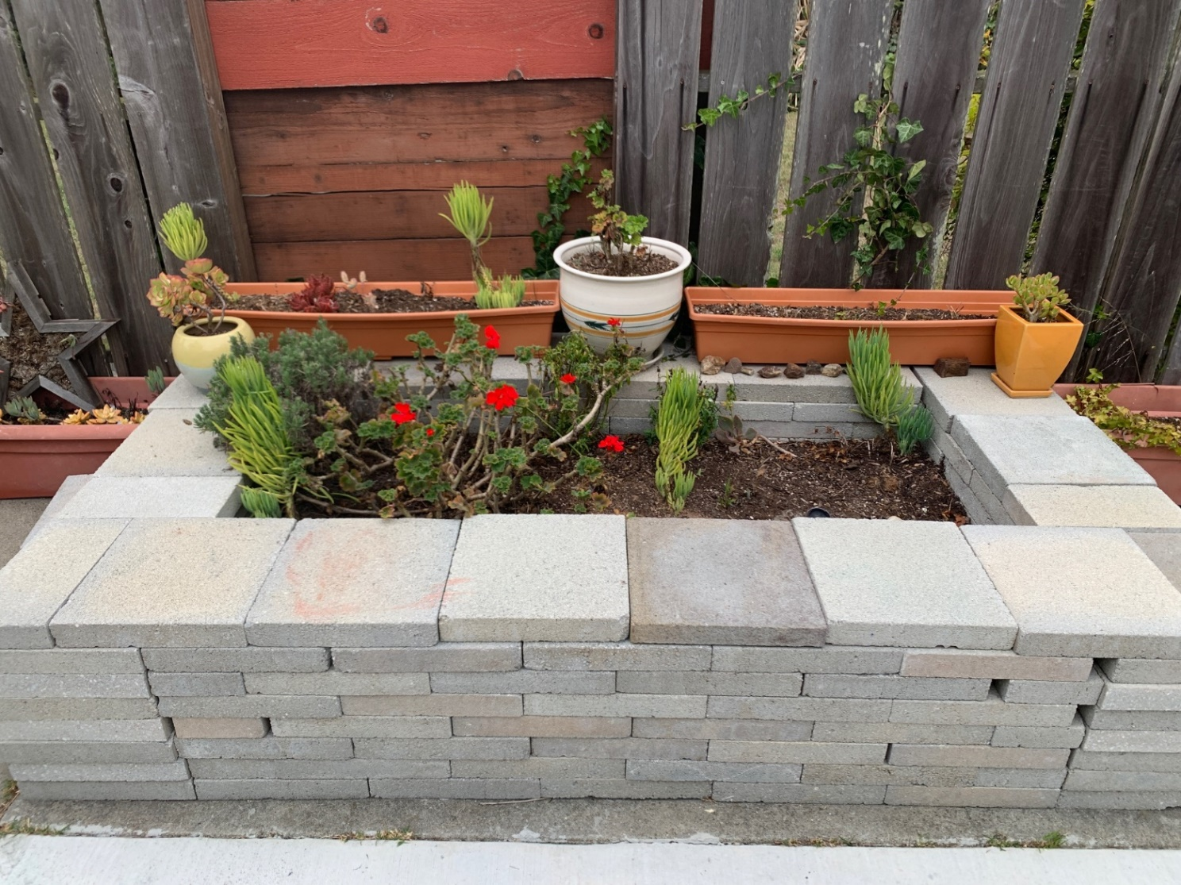
Governance Gardeners
Notes:
Things will die. Things will thrive despite us; others will thrive because of us. Things will be overwatered. Things will not get enough water. We are not going to become professional gardeners. We only meet for 10 hours over the course of the year. We recognize that our influence is limited but it is also real, so let’s plant some seeds, remember to water them, and see what we can grow.

